Slide 1
Multiple Linear Regression Case Study
A study of Elementary Schools in California
Submitted by: Vishesh Goel

Slide 2
Objective
To build a Multiple Linear Regression Model to predict the Average Performance Index (API) of Elementary Schools for the year 2000 in California, based on various contributing factors.

Slide 3
About this presentation
The presentation outlines the key results of the predictive model that predicts the API for year 2000 as well as the interpretations of the statistics obtained.

Slide 4
Approach
Software Used: SAS
Method Used: Linear Regression
Algorithm Used: Ordinary Least Squares Method
Notes:
For the coding part of the case study, please refer to ‘Codes Model1_7.doc’.

Slide 5
Questions To Answer
What are the most significant factors that determine the performance of elementary schools in year 2000 in California?
How are these factors related to the performance of elementary schools?
To what extent do these factors affect the performance of elementary schools?

Slide 6
About the dataset
Data of 21 various attributes like class size, enrollment, funding, parent education, student performance, teachers’ credentials from 400 elementary schools from the California Department of Education's API 2000 dataset. (Source: https://www.data.gov).

Slide 7
VARIABLE NAME | Label
acs_46 | class size 4-6
acs_k3 | class size k-3
api00 | Academic Performance Indicator 2000
api99 | Academic Performance Indicator 1999
avg_ed | Average number of Years of High school parent education
col_grad | % of Parents who are college grad
Dnum | district number
Ell | % of Students who are English language learners
Emer | % of part Time Teachers
Enroll | Number of students
Full | % of full Time Teachers
grad_sch | % of Parents who are attended grad school
Growth | growth 1999 to 2000
Hsg | % of Parents who are high school graduate
mealcat | free meals in 3 categories
Smeals | % of Students who opt for free meals
mobility | Dropout Rate
not_hsg | % of Parents who are not high school graduate
Snum | school number
some_col | % of Parents who are attended some college
yr_rnd | year round school – School open through the year or not
Description Of Variables
Api00 is the dependent variable in the model, as highlighted in green.
Api99 and Growth variables can compute Api00, so we drop them for the analysis point of view.
Also, Snum and Dnum will be dropped from the analysis since they are just like ID variables here.

Slide 8
The Regression Equation
Estimated (Api00) = (566.51535) – (2.26654*meals) – (1.13465*ell) - (25.14417*yr_rnd)
- (1.81631*mobility) + (4.69048*acs_k3) + (2.03543*acs_46)
+ (0.63746*col_grad) + (2.05598*grad_sch) + (1.39318*full)
Statistical and Practical Significance of Variables
For a unit increase in Meals, Api00 decreases by 2.27. This is because an increase in percentage of free meals indicates the poverty among students, which is expected to bring down the API.
For a unit increase in Ell, Api00 decreases by 1.13. This is because a higher percentage of English language learning students may indicate students with low general aptitude, which affects the API negatively.
For a unit increase in Yr_rnd, Api00 decreases by 25.14. This could be due to lack of vacations and breaks which adversely affects the morale of the students and hence, their performance.

Slide 9
Statistical and Practical Significance of Variables
For a unit increase in Mobility, Api00 decreases by 1.82. This is because as dropout rate of the students increase, it negatively affects the API.
For a unit increase in Acs_k3 & Acs_46, Api00 increases by 4.7 and 2.03 respectively. This is because increase in class sizes results into more competition and hence, better performance.
For a unit increase in Col_grad & Grad_sch , Api00 increases by 0.637 and 2.055 respectively. This is because the more educated parents are, the more they closely monitor the education of children and provide better facilities, which improves the performance of children. This increases the API of school.
For a unit increase in Full, Api00 increases by 1.39. This is because the more the percentage of Full-time teachers, the better is the teaching quality, which increases the performance of students and hence, increases API.

Slide 10
MLRM Model Results
We evaluate the accuracy of the model and the significance of overall model as well as individual regressor variables in the model.

Slide 11
Overall Significance of Regression (F Test)
Analysis of Variance
Source | DF | Sum of | Mean | F Value | Pr > F
 |  | Squares | Square
Model | 9 | 5972990 | 663666 | 212.07 | <.0001
Error | 337 | 1054638 | 3129.48973
Corrected Total | 346 | 7027628
F Statistic = 212.07
P-value <0.0001 i.e. we reject null hypothesis at 99.9% level of significance.
Therefore, we conclude that the overall regression model is significant.

Slide 12
Significance of Individual Regressors (t-Test)
Variable | t Value | Pr > |t|
Intercept | 10.32 | <.0001
meals | -10.32 | <.0001
ell | -5.36 | <.0001
yr_rnd | -2.9 | 0.0039
mobility | -3.97 | <.0001
acs_k3 | 1.99 | 0.047
acs_46 | 2.42 | 0.016
col_grad | 2.68 | 0.0078
grad_sch | 6.38 | <.0001
full | 5.65 | <.0001
All the regressor variables have significant t-values, and hence, low p-values.
Meals, Ell, Mobility, Grad_sch and Full are all statistically significant at 99.9% level of significance.
Yr_rnd and Col_grad are significant at 99% level of significance.
Although Acs_k3 and Acs_46 show a relatively weaker significance, these variables are also significant at 95% level of significance.

Slide 13
Goodness of Fit (R-square)
R-Square | 0.8499
Adj R-Square | 0.8459
All the explanatory variables jointly explain 84.99% of variations in the target variable i.e. Api00.
Small difference between R-square and Adjusted R-square indicates that there is no problem of ‘Over-fitting’ of the model.

Slide 14
Prediction Accuracy of Model
Mape
7.81432
The Mean Absolute Percentage Error (MAPE) of 7.81432 indicates that the model is likely to predict the target variable with an average of 7.81% of actual observations.

Slide 15
MLRM Diagnostics
After building the model, we must check if the model satisfies some fundamental assumptions of a Linear Regression Model.

Slide 16
Multicollinearity Check (VIF)
Variable | Variance
 | Inflation
Intercept | 0
meals | 4.12763
ell | 3.19717
yr_rnd | 1.43469
mobility | 1.21152
acs_k3 | 1.1429
acs_46 | 1.13382
col_grad | 1.57069
grad_sch | 1.59294
full | 1.55387
All the variables except Meals and Ell have a VIF which is less than 1.7, which suggests insignificant collinearity among these variables.
Although Meals and Ell have higher VIF than the rest of the variables, these are still within our conventional limit of VIF = 10.
This suggests that the model is free from the problem of multicollinearity.

Slide 17
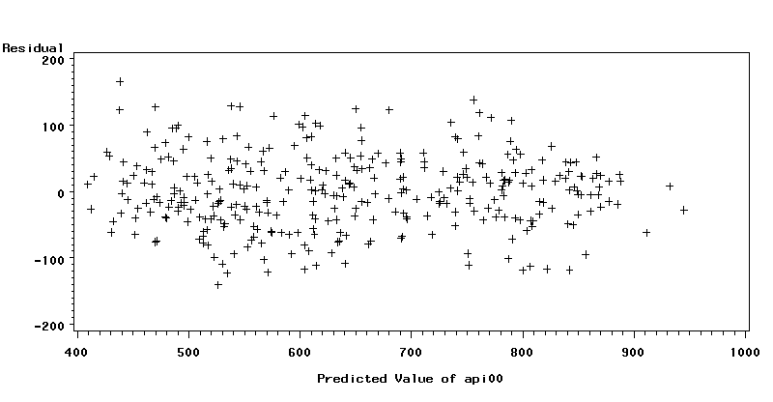
Homoscedasticity Check (White Test)
Chi-Square | Pr > ChiSq
65.73 | 0.1126
Since p-value > 0.001, we do not have enough evidence to reject null hypothesis that error variance is constant across the range of variables.
Therefore, we conclude that the errors are homoscedastic.
The randomness in the Residual vs Predicted graph further indicates the homoscedasticity of errors.

Slide 18
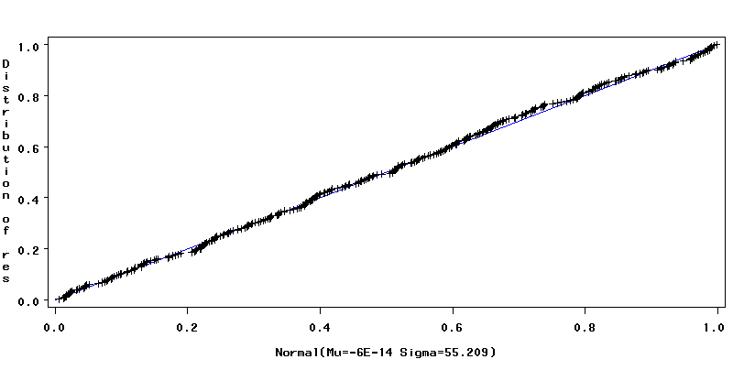
Normality of Residuals (Shapiro-Wilk Test)
Tests for Normality
Test | Statistic |  | p Value
Shapiro-Wilk |  | 0.995467 |  | 0.4115
Kolmogorov-Smirnov |  | 0.027709 |  | >0.1500
Cramer-von Mises |  | 0.036877 |  | >0.2500
Anderson-Darling |  | 0.304869 |  | >0.2500
P-values are high for each test i.e. we do no have enough evidence to reject null hypothesis that the distribution is Normal.
Therefore, we conclude at 99.9% level of significance that Residuals are normally distributed.
This confirms that the t-test for significance of individual regressors is valid.
In the QQ-Plot above, distribution of Residuals is almost overlapping the diagonal line, which strongly suggests that Residuals are Normal.

Slide 19
Autocorrelation Check (Durbin Watson Test)
Durbin-Watson D 1.422
DW-Statistic, D = 2 is considered to be no autocorrelation.
In real world problems, it is practically rare to obtain D = 2. We want to be as close to 2 as possible, which allows some level of margin of error for DW-Statistic.
D = 1.422 suggests some level of positive autocorrelation, but it may be allowed in the model since it is not a critical condition.

Slide 20
Final Insights From The Model
The model so obtained satisfies all the benchmark values for various statistics and does not violate any fundamental assumptions of a model, which indicates that it is a well-built model.
The model takes into account many important factors to predict the API such as poverty(meals), aptitude of students(ell, mobility), parents’ education(col_grad, grad_sch), teachers’ credentials(full), class sizes(acs_k3, acs_46), schedule of school(yr_rnd).
This suggests that the model is insightful and sophisticated.

